Slide 1
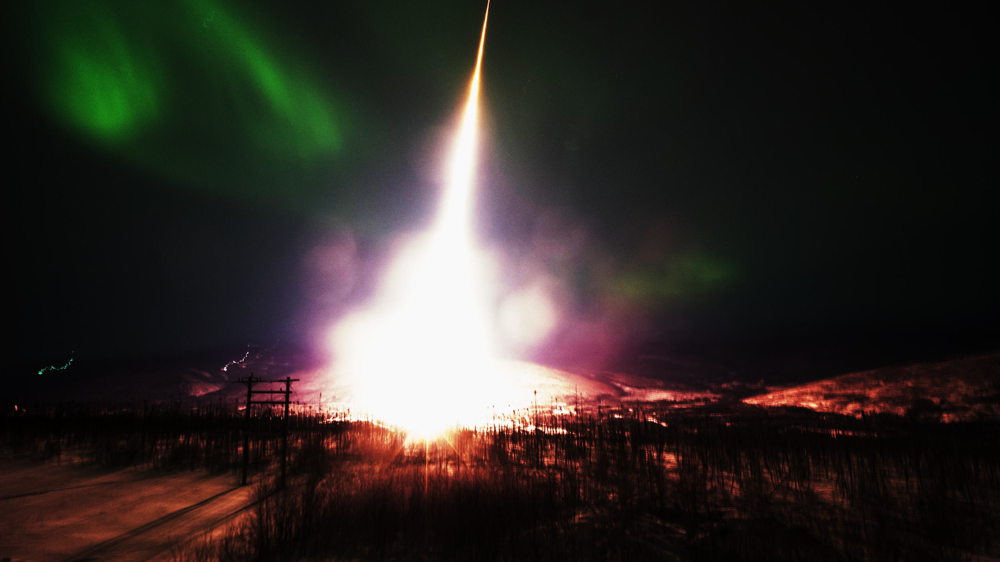


UPR RockSat X Norway Preliminary/Critical Design Review
University of Puerto Rico
Jan 3, 2018
PDR/CDR Version 3

Slide 2
1.0 Mission Overview

Slide 3
Mission Statement
To perform spectroscopy measurements for characterization of the Aurora Borealis organic gas composition by designing and building an experimental payload that exposes students to a professional and interdisciplinary, aerospace, work environment.

Slide 4
Mission Overview: Mission Objectives
Perform measurements using photon emission spectroscopy in the UV-VIS and NIR spectrum, where we expect to identify NH2, NH, C2H, C2H2, or any other organic substance.
Measure temperature and pressure in function of altitude during flight.

Slide 5
Mission Overview: Theory and Concepts
UV-Vis-NIR Emission Spectroscopy: In order to validate or confirm the presence of organic compounds we intend to do UV spectroscopy. Since amino groups tend to have emission spectra in the UV range, this is ideal. In principle this consist of excitation of the organic compounds with charged particles of the Aurora Borealis, the organic groups will absorb energy from the high energy particle of the solar winds and jump to an excited state.

Slide 6
Mission Overview: Theory and Concepts
The light emitted will corresponds to the energy differences of the molecules state of the organic compounds. The Pi-electrons of the molecule will jump from the highest occupied molecular orbital to the lowest unoccupied molecular orbital emitting a photon. This photon energy is characteristic for each different molecule, so they can be identified by the fine structure optical spectroscopy.

Slide 7
Mission Overview: Success Criteria
Our minimum success criteria would be to obtain results from at least two of the three experiments measurements, which include temperature, pressure and successfully detecting photons from the UV-VIS-NIR spectrum.
The comprehensive success criteria would be to obtain results from the three experiments.

Slide 8
Mission Overview: Expected Results
We expect to detect, through UV/Vis/NIR spectroscopy (in 400nm-800nm for UV/Vis), organic compounds such as: NH₂, NH and C₂H.
We also expect to obtain data of pressure and temperature from the high latitudes that the rocket would be launched.

Slide 9
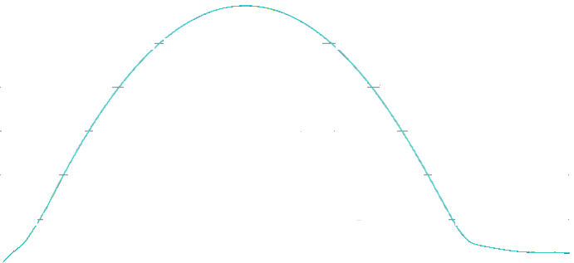
Mission Overview: Concept of Operation*
Altitude
t = 70 sec
Altitude: 76 km
Signal flag for aft skirt deployment/ spectroscopy collection
Apogee
t = 201 sec Altitude: ≈156 km
t = 308 sec
Altitude: 86 km
2 sec to Power off
t = 0 sec
Altitude: 0 km
Launch Flag Trigger/ All systems on
t = 29 sec
Altitude: 17 km
Malemute Burnout
t = 338 sec
Altitude: 68.9 km
Payloads Power OFF
t = 470 sec
4.7 km
Chute Deploys
t = 5 sec
Altitude: 1.5 km
Terrier Burnout
t = -240 sec
Turn on thermocouples/ Pressure Gauge
*Using Mission Time Line 46.005/Koehler rev. 8/5/13
t = 676
Payload Impact

Slide 10
Concept of Operations
Timer Events Matrix
Event | Time On | Dwell | Event Description
GSE 1 | T-240 sec | 540 sec | Turn on thermocouples and pressure gauge, Computer, Spectrometer
GSE 2 | T-240 sec | 540 sec | Turn on thermocouples and pressure gauge, Computer, Spectrometer
TE-1 | T=000 sec | 360 sec | Launch signal
TE-2 | T+70 sec | 360 sec | Spectroscopy Start Collection
TE-3 | T+336 sec | 360 sec | 2 sec before payloads power off
TE-R | T=000 sec | 360 sec | Launch signal, more power

Slide 11
2.0 System Overview

Slide 12
System Overview: Science Design
Subsystem | Instruments | Purpose
UV Spectroscopy | UV/VIS/NIR Spectrometer 200 - 800nm | Detect Photon Spectrum (200nm - 800nm)
 | Collection Lens
Environmental | Pressure Gauge | Measures space vacuum pressure in function of altitude
 | Thermocouples | Measures temperature in function of altitude

Slide 13
System Overview: Engineering Design
Structure | Components | Location
Flight Computers, Data Management and Others | Intel NUC i5, ADC, Proximity Sensor | Intel NUC Enclosure Proximity Sensor to be determined
Power Supplies | DC-DC Converters | Electrical Tower
Mechanical | Electrical Tower, Computer and Spectrometer Enclosures | NASA Plate

Slide 14
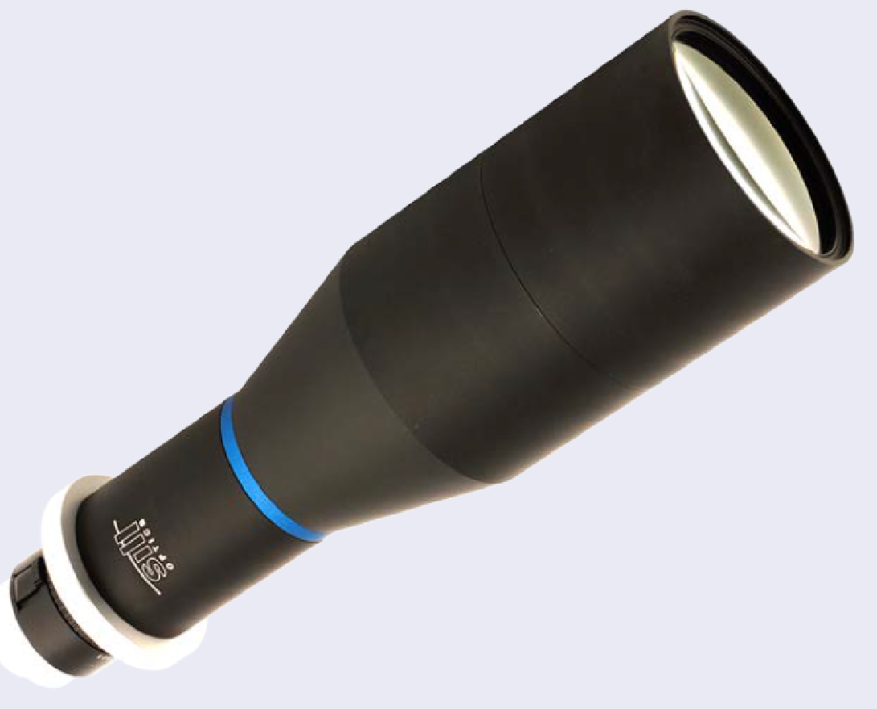
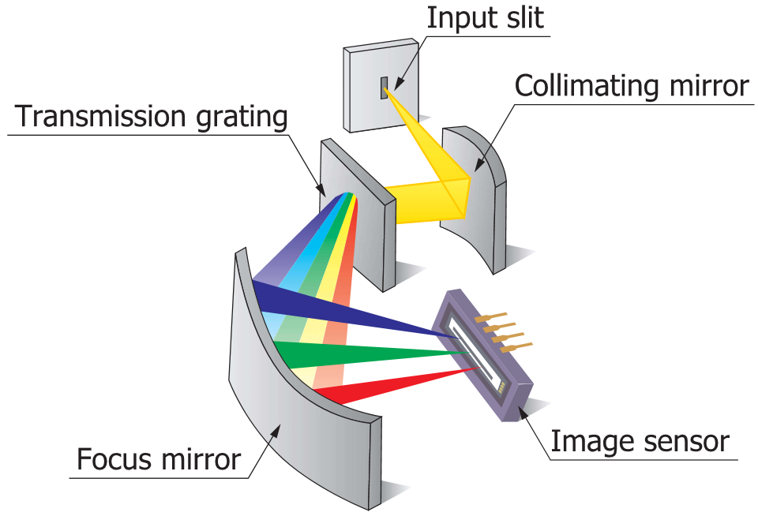
Design Overview: Functional Block Diagram
Wallops Power
Power Convector
GSE1
28-12 V DC-DC
TE-RA
28-5 V DC-DC
TE-RB
TE-1
28-24 V DC-DC
Spectrometer
GSE2
Timer Event Voltage Sensor
TE-2
TE-3
Wallops Telemetry
Computer System
ADC
Serial Data
Proximity Sensor
Environmental System
ADC/USB
Thermocouples
Intel NUC
Power Line
Digital Signal
Analog Signal
USB
RF Coax
Pressure Gauge
Micro SD Card

Slide 15
System Overview: Mechanical Design
Give me a brief overview of your final mechanical design
Mechanical drawings should be included with your other CDR deliverables
Solid models (labeled and dimensioned) with many views should be included
Expecting multiple views (top, bottom, side, and iso views)
Any stress/strain analysis?
Material choices?
Notes:
Downward-viewing auroral imager

Slide 16
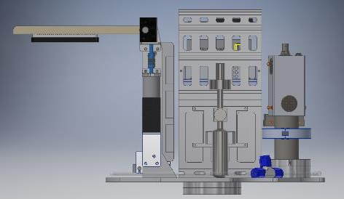
Design Overview: Payload Layout

Slide 17
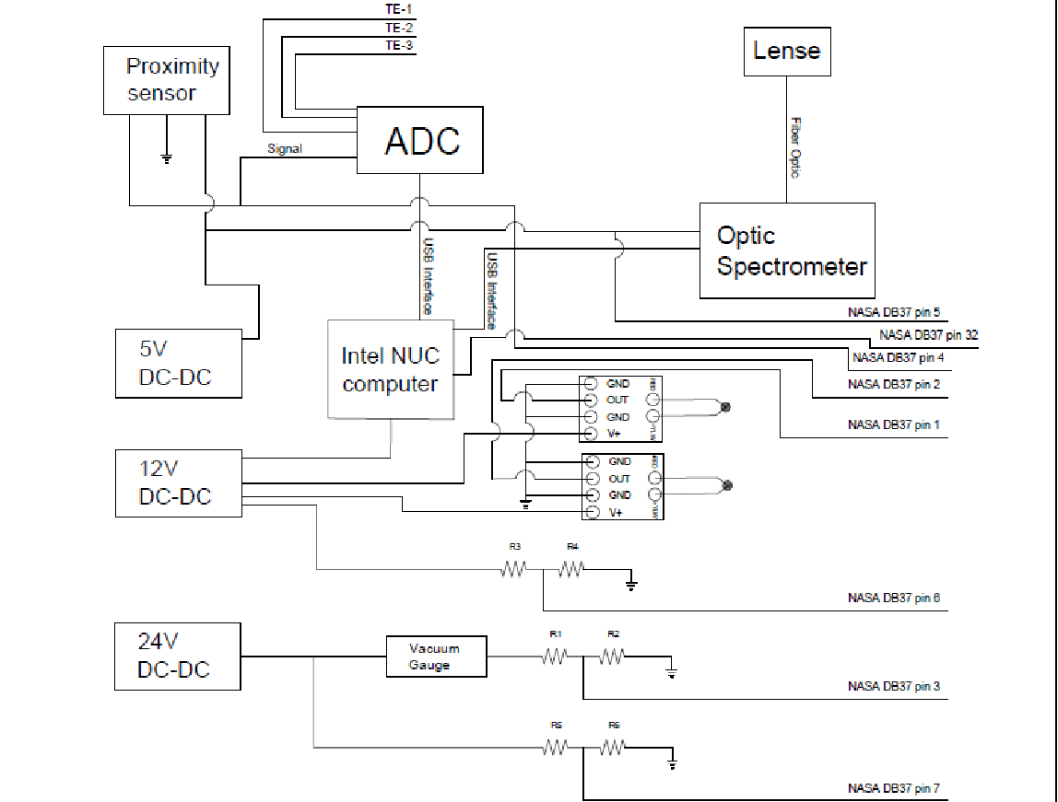
System Overview: Electrical Design

Slide 18
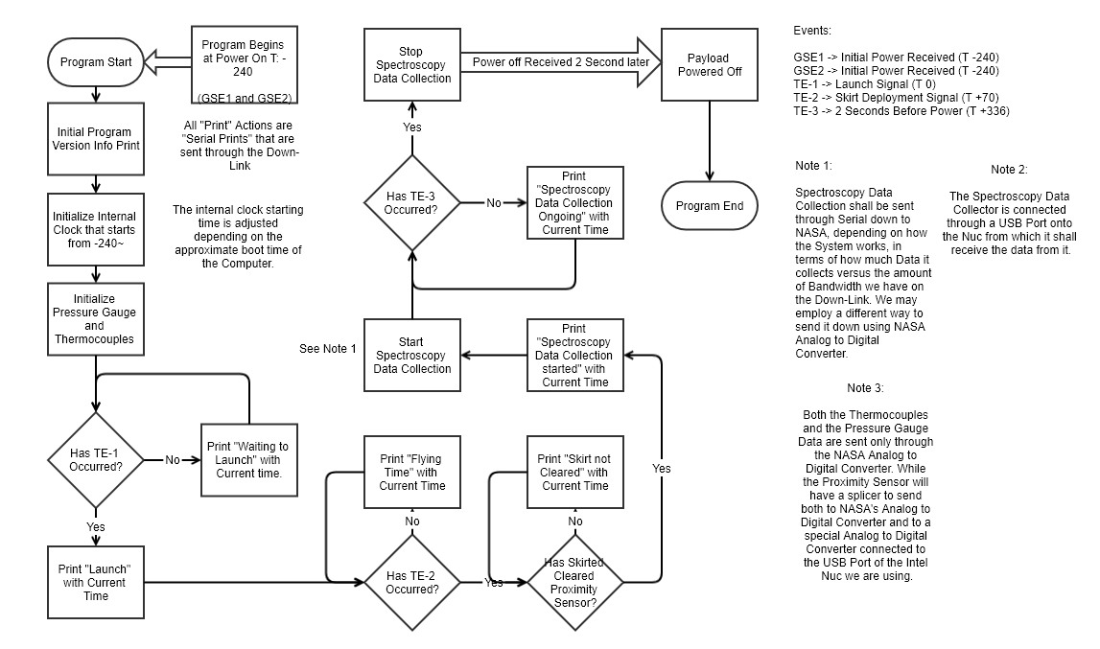
System Overview: Software Design

Slide 19
System Overview Description of Partnerships
NASA Wallops Flight Facility
Fly, integration and environmental tests. Provide students the opportunity to develop a hardware project that is launched to space on a sounding rocket.

Slide 20
System Overview Description of Partnerships
Colorado Space Grant Consortium
Establish the RockSat-X program that maintains the organization and structure that give access to college students to develop an experimental payload that flies to space.

Slide 21
System Overview: Description of Partnerships
Interamerican University-Bayamon Campus
Analyze the collected data for organic compounds
School of Machining (ETH)
Construction of the aluminum structure

Slide 22
System Overview: Description of Partnerships
Bifrost Documentary
Video documentary

Slide 23
De-Scopes and Off-Ramps
De-Scopes | Non
Off-Ramps | Sphericam 3D Camera | Complex Recovery, incomplete planning and design, risky chemical reaction requested, more than 5 pounds.

Slide 24
System Overview: Special Requests
Request 0.85” below deck
Request to be at the Bottom Deck

Slide 25
3.0 Subsystem Design

Slide 26
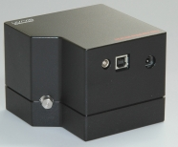
UV/VIS/NIR Optical Spectrometer 200-800nm
Function:
- Detect photon spectrum from 200 nm – 800 nm (UV-NIR)
Power/Data needs:
- 5.0 Volts – 100 mA – 0.5 Watts
Mechanical Interface:
- TBD
Electrical Interface:
- Powered by computer (to be determined)
Weight/Dimensions/Specifications:
- Weight: 2.0 lbs.
- Dimensions: 11 x 11 x 90 cm

Slide 27
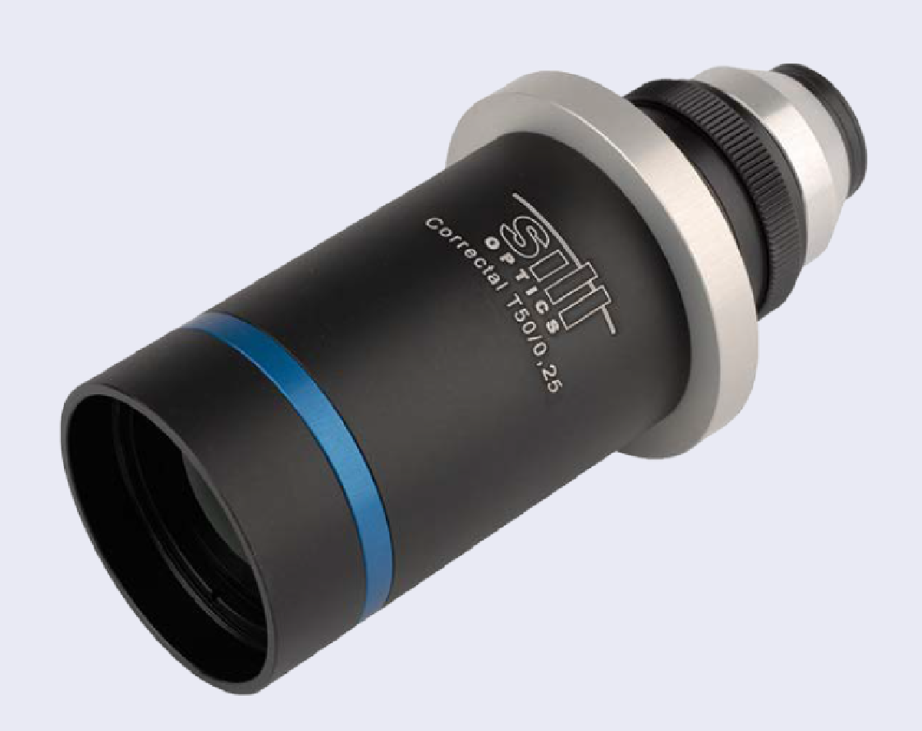
Collection Lens
Function:
-Collect Photons from the Aurora Borealis Charge particle excitations
Power/Data needs:
-Non
Mechanical Interface:
- On the top Deck Side
Electrical Interface:
-Non, need an optical interface by Fiber Optics Cable
Weight/Dimensions/Specifications:
-Weight: 1.5 lbs.
-Dimensions: 8” x 3” ø

Slide 28
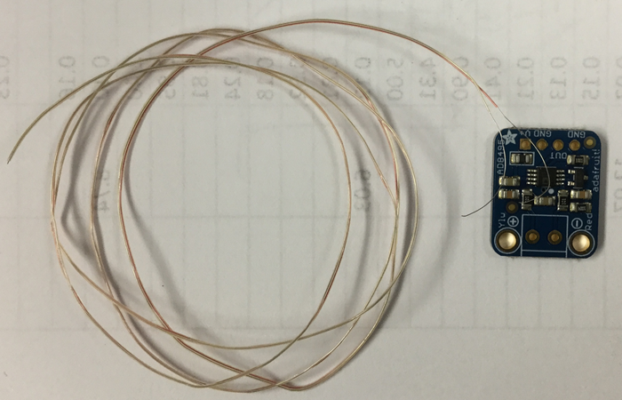
Subsystem Design(Science): Thermocouples
Function:
- Measure the temperature in the payload.
Power/Data needs:
-1 W. Pressure dependent 0v-5v
Mechanical Interface:
-In electrical tower.
Electrical Interface:
-Powered by 28-5 V DC-DC converter
Weight/Dimensions/Specifications:
-Weight: .0029 lbs.

Slide 29
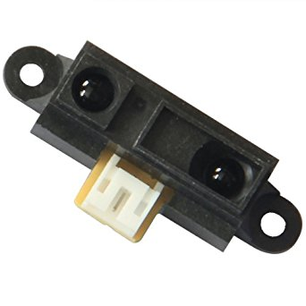
Proximity Sensor
Function:
- Detect skirt deployment
Power/Data needs:
- 5V – 0.04 A 0.2 Watts
Mechanical Interface:
- TBD, side mount
Electrical Interface:
- Powered by 28V-5V DC-DC converter. Signal sent to ADC/computer
Weight/Dimensions/Specifications:
- Weight: 0.01 lbs
- Dimensions: 1.6” x 0.9” x 0.6”

Slide 30
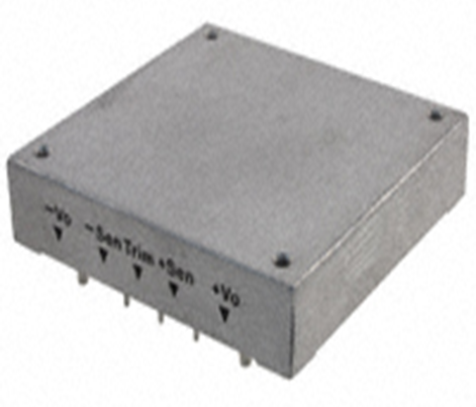
Subsystem Design (Power): 28V-24V DC-DC Converter
Function:
-Powers Vacuum Gauge
Power/Data needs:
-Receives 28V
-Sends 24V
Mechanical Interface:
-Electrical Tower
Electrical Interface:
-Powered by 28V-24V DC-DC converter
Weight/Dimensions/Specifications:
-Weight: 0.20 lbs.
-Dimensions: 2.40” x 2.28” x 0.50”

Slide 31
Subsystem Design(Power): 28V-12V DC-DC Converter
Function:
-Powers Intel NUC
Power/Data needs:
-Receives 28V
-Sends 12V
Mechanical Interface:
-Electrical Tower
Electrical Interface:
-Powered by GSE 1 and 2, as well as WFF Power Time Events R1, R2, 1, 2, and 3.
Weight/Dimensions/Specifications:
-Weight: 0.20 lbs.
-Dimensions: 2.40” x 2.28” x 0.50”

Slide 32
Subsystem Design (Power): 28V-5V DC-DC Converter
Function:
-Powers Thermocouples, and Proximity Sensor
Power/Data needs:
-Receives 28V
-Sends 5V
Mechanical Interface:
-Electrical Tower
Electrical Interface:
-Powered by 28V-5V DC-DC converter
Weight/Dimensions/Specifications:
-Weight: 0.20 lbs.
-Dimensions: 2.40” x 2.28” x 0.50”

Slide 33
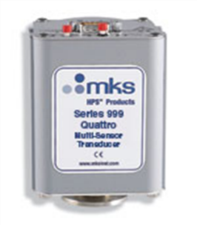
ES: Sensor Vacuum Gauge (999 Quattro Multi)
Function:
- Measures ambient pressure and communicates it in signals of 0-5 V.
Power/Data needs:
- 24V 2 Amp
- Receives 24V from 28V-24V DC-DC converter
Mechanical Interface:
-NASA Plate
Electrical Interface:
- Powered by 28V-24V DC- DC converter
- Sends data through WFF telemetry pin 3 (Analog 3)
Weight/Dimensions/Specifications:
- 1.01 lbs.
- 5.52” x 2.91” x 3.10”

Slide 34
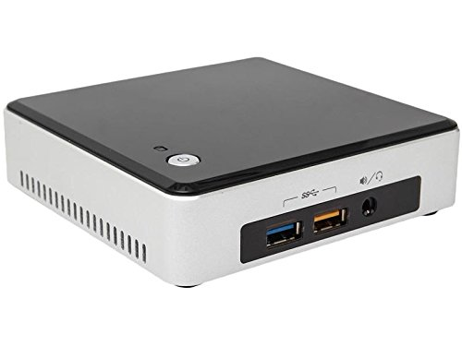
Intel NUC 7I5NKE
Function:
- Runs the spectrometer, sends the serial data telemetry, and received the flagged time events to control the experiment data.
Power/Data needs:
- 12 Volts, 65W, 5.5 Amps
Mechanical Interface:
- NASA Plate with its own enclosure
Electrical Interface:
- See schematic diagram
Weight/Dimensions/Specifications:
- Weight: 0.9 lbs.
- Dimensions: 5.4 ” x 3.9 ” x 4.92 ”

Slide 35
Detailed Weight Budget
Subsystem | Component | Weight (lb)
 | NASA Plate Deck | 3.3 | 10.3
UV/VIS/NIR | Spectrometer 200-800 nm | 3.5
 | Collection Lens | 3.5
Electrical Tower | Tower | 5.745 | 12.253
 | Proximity Sensor | 0.008
 | Power Converters (x3) | 1.5
 | Intel NUC Computer | 5
 | Wire Harness | 3 | 3
 | Ballast | 4.5
TOTAL |  | 25.553
Over/Under |  | 30.053

Slide 36
Subsystem Design: Detailed Power Budget

Slide 37
Risk Matrix: Flying Computer
Consequence | EPS.RSK.2 | EPS.RSK.1 EPS.RSK.3
 | Possibility
Mission Objective: Runs the spectrometer, sends the serial data telemetry, and received the flagged time events to control the experiment data.
EPS.RSK.1:Mission objectives aren’t met IF flying computer fails in-flight
EPS.RSK.2:Computer works but doesn’t transmit telemetry
EPS.RSK.3:Computer works but doesn’t control optical spectrometer
Notes:
Don’t know about this one, it’s iffy

Slide 38
Risk Matrix: Optical Spectrometer
Consequence
 |  | EPS.RSK.1 EPS.RSK. 2 EPS.RSK.3
 | Possibility
Mission Objective: Detect photon spectrum from 200 nm – 800 nm (UV-NIR)
EPS.RSK.1: Optical Spectrometer fails to collect properly
EPS.RSK.2: Vibration damages internal optics
EPS.RSK.3: Fail to send Data
Notes:
Don’t know about this one, it’s iffy

Slide 39
Risk Matrix: Pressure Gauge
Consequence
 |  | EPS.RSK.2 EPS.RSK.1
 | Possibility
Mission Objective: Measures ambient pressure and communicates it in signals of 0-5 V.
EPS.RSK.1:Fail to measure Pressure
EPS.RSK.2:Fail to send Data
Notes:
Don’t know about this one, it’s iffy

Slide 40
Risk Matrix: Thermocouples
Consequence
 |  | EPS.RSK.2 EPS.RSK.1
 | Possibility
Mission Objective: Measure the temperature in the payload.
EPS.RSK.1: Fail to measure temperature
EPS.RSK.2: Fail to transmit Data
Notes:
Don’t know about this one, it’s iffy

Slide 41
Risk Matrix: Power Supplies
Consequence |  | EPS.RSK.1
 |  | EPS.RSK.2
 |  | EPS.RSK.3
 | Possibility
Mission Objective: Provide power to all subsystems
EPS.RSK.1: Doesn’t power any subsystem
EPS.RSK.2: Doesn’t power two of three subsystems
EPS.RSK.3: Doesn’t power one subsystem
Notes:
Don’t know about this one, it’s iffy

Slide 42
4.0 Prototyping/Analysis Results/Plans

Slide 43
Prototyping Plan: Optical Spectrometer
The Optical Spectrometer needs to be tested for optical spectroscopy as a full integrated system
Analyze the spectrum data to be efficiently transferred by telemetry

Slide 44
Prototyping Plan: Pressure Gauge
The instrument needs to be tested as a full integrated system
Evaluate if it measures pressure correctly
Transferred telemetry properly

Slide 45
Prototyping Plan: Thermocouples
The instrument needs to be tested as a full integrated system
Evaluate if it measures temperatures correctly
Transferred telemetry properly

Slide 46
5.0 Manufacturing Plan

Slide 47
Manufacturing Plan: UPR RockSat-X Norway 2019

Slide 48
Mechanical Elements
Computer and spectrometer enclosure, and the Electronic Tower will be manufactured.
The Collector Lens, Optical Spectrometer, Intel NUC, ADC/USB, Vacuum gauge, Power Supplies, and miscellaneous will be purchased.

Slide 49
Electrical Elements
Harness and interconnections for all subsystems
To see the testing/prototyping schedule refer to Manufacturing Plan.

Slide 50
Software Elements
All software blocks are going to be develop.
On the blocks sequencing only the loops blocks depend on the secondary blocks.
For the planning schedule please refer to the manufacturing plan

Slide 51
6.0 Testing Plan

Slide 52
Testing Plan: Testing Overview
Describe, in general terms, how you will test each of the subsystems in your Functional Block Diagram
Goal is to eventually test your design as it will be flown
Test plans should builds on the success of each test. For example, test power conversion subsystem before powering the instrument
Testing should have a logical flow
Include what risks these tests will help mitigate

Slide 53
Testing Plan: Mechanical Testing
Consider subsystem level requirements to be verified (weight/volume/vibration…)
Present a brief overview of the tests you need to conduct to verify these requirements
When will these tests be performed?
Call-out any deployment tests and how they will be preformed
Discuss any mechanical inhibits you may need for Wallops testing

Slide 54
Testing Plan: Electrical Testing
Consider subsystem level requirements to be verified (sample rate/deployment tests…)
Present a brief overview of the tests you need to conduct to verify these requirements
When will these tests be performed?
Callout any high voltage components
Callout any internally powered components and how they will be tested
Discuss any electrical inhibits you may need for Wallops testing

Slide 55
Testing Plan: Software Testing
Consider how software and electrical depend on each other for testing
Present a brief overview of what portions of the code need to be completed to test the electrical system at its various testing points
When will these tests be performed?
Discuss any software inhibits you may need for Wallops testing

Slide 56
Testing Plan: System Level Testing
Present an overview of the tests you need to conduct at the system level
Consider an stepped approach to testing subsystems to get to the System Level
Mission Simulations should be a part of that
When will these tests be performed?

Slide 57
Top Level Requirements:
Requirement | Verification Method | Description
Optical Spectroscopy: detect photon spectrum from 200 – 800 nm (UV-NIR) | Demonstration | Spectrometer will measure and send the collected spectrum by telemetry
Pressure Gauge Measurements: measure the pressure vs altitude | Demonstration | The instrument will measure pressure and send the data by telemetry.
Temperature Measurements: measure temperature in function of altitude | Demonstration | The instrument will measure temperature and send the data by telemetry
The sytem shall survive the vibration characteristics prescribed by the RockSat-X program. | Test | The system will be subjected to these vibration loads in June during testing week.

Slide 58
7.0 User Guide Compliance

Slide 59
User Guide Compliance: Summary
Requirement | Status/Reason (if needed)
Center of gravity in 1" plane of plate? | Yes
Weight 30.0+/- 1.0 (15.0 +/- 0.5) lbs? | Yes
Max Height < 10.75” (5.13”) | Yes
Bottom of deck has flush mount hardware? | No, we request 0.85” below deck
Within Keep-Out Zone | Yes
Using < 10 A/D Lines | Yes
Using/Understand Parallel Line | Yes
Using/Understand Asynchronous Line | Yes
Using X GSE Line(s) | Yes
Using X Non-Redundant PWR Lines (TE-1, TE-2, TE-3) | Yes
Using X Redundant Power Lines (TE-R) | Yes
Using < 1 Ah | Yes
Using <= 28 V | Yes
Using RF (If yes, list frequency and TX Power) | No
Using deployable? | No
Whole team consists of US Persons | Yes
Using ITAR and/or Export Controlled hardware | Yes
We request our payload to be placed on the bottom deck for these devices to function as intended.
We would really love to keep power after T+338 seconds for Spectra subsystem. The instrument will continue the collection UV/VIS/NIR Optical Spectrums before splash at the ocean.

Slide 60
User Guide Compliance: Power Interface
Power Connector--Customer Side
Pin | Function
1 | GSE 1, Turn on thermocouples and pressure gauge, computer, Spectrometer
2 | Time event redundant (TE-RA), Launch Signal, More Power
3 | Time event redundant (TE-RB), Launch Signal, More Power
4 | Time event 1 (TE-1), Launch Signal
5 | GND
6 | GND
7 | GND
8 | GND
9 | GSE 2, turn on thermocouples and pressure gauge, computer, Spectrometer
10 | Time event 2 (TE-2), Spectroscopy Start Collection
11 | Time event 3 (TE-3), 2 sec. before payload power off
12 | GND
13 | GND
14 | GND
15 | GND

Slide 61
User Guide Compliance: Telemetry Interface
Telemetry Connector--Customer Side
Pin | Function | Pin | Function
1 | Thermocouple 1 | 20 | N/C
2 | Thermocouple 2 | 21 | N/C
3 | Pressure Gauge | 22 | N/C
4 | Pressure Sensor | 23 | N/C
5 | 5 V supply | 24 | N/C
6 | 12 V supply | 25 | N/C
7 | 24 V Supply | 26 | N/C
8 | N/C | 27 | N/C
9 | N/C | 28 | N/C
10 | N/C | 29 | N/C
11 | N/C | 30 | N/C
12 | N/C | 31 | N/C
13 | N/C | 32 | Computer Serial Port
14 | N/C | 33 | GND Serial Port
15 | N/C | 34 | N/C
16 | N/C | 35 | N/C
17 | N/C | 36 | GND
18 | GND | 37 | GND
19 | GND

Slide 62
8.0 Project Management Plan (PMP)

Slide 63
Team Organization Chart
Sections | Members
Mission Overview: Mission Statement Mission Objective Theory and Concepts Concept of Operation Expected Results | Oscar A. Resto Keishla Robles María Rivera José J. Maldonado
Design Overview: Science Design Engineering Design Functional Block Diagram Payload Layout (sketches) RockSat-X User’s Guide Compliance | Luis López Ángel Colon Eric De León Luis E. González Camila Casares Hazel Rivera Gustavo Oquendo Alexis Oquendo
Management: Team Organization Schedule Budget Mentors (Faculty, industry) Risks/Worries Contact and Availability & Matrixes | Keishla Robles Carlos A. Roig Alexis Oquendo

Slide 64
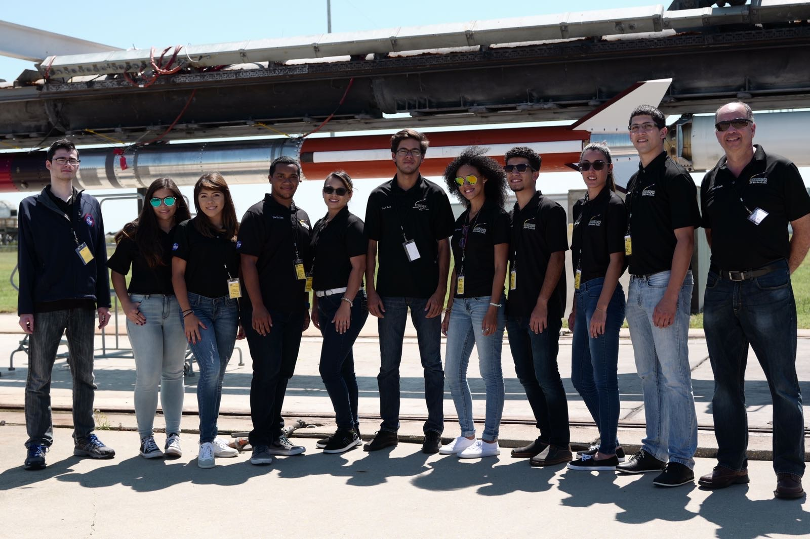
Team Picture

Slide 65
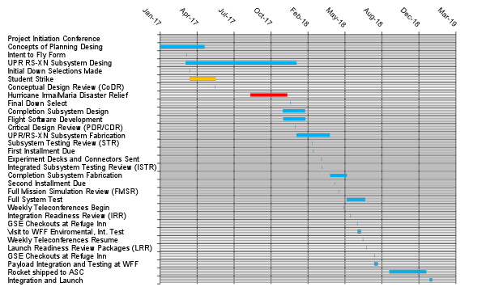
Schedule for UPR RockSat-X Norway 2019

Slide 66
Project Management Plan:
UPR RockSat- XN 2019
Science
Mechanical Engineering
Physicist
Chemist
Genomics Sequencing
Computer Sciences
Alexis Oquendo (Team Leader)
Camila Casares
Hazel Rivera
Gustavo Oquendo
Carlos A. Roig
Oscar A. Resto
José J. Maldonado
Maria Rivera
John Wilson
Administration
Electrical Engineering
Class 2017-2018
Eric de León
Ángel Colon
Luis López
Keishla Robles
Alexis Oquendo
Carlos A. Roig
Faculty
Oscar Resto Principal Investigator
Steve Massey, PhD. Bioinformatics Genomics
Liz Diaz, PhD. Analytical Chemistry
Gerardo Morell, PhD. Physics
Vladimir Makarov, PhD. Physics
Ashley A. Matchett, PhD. Genomic Forensics
Sponsors
NASA Wallops F.F.
School of Machining Construction
Bifröst Documentary
Interamerican University – Bayamon Campus
Colorado Space Grant Consortium

Slide 67
Contact Matrix:
Team Name/University of Puerto Rico
RS-XN Contact Matrix
Role | Name | Day Phone | Cell Phone | Receive Texts? | Email | Citizenship | Add to mailing list?
PI | Oscar Resto |  | 787-345-6088 | Yes | Oscar.resto@live.com | U.S. | Yes
Graduate student | Maria Rivera |  | 787-451-9592 | Yes | mariaivelisse19@gmail.com | U.S. | Yes
Graduate Student | Oscar A. Resto |  | 787-345-1944 | Yes | oscar.ariel.resto@live.com | U.S. | Yes
 | Alexis Oquendo |  | 787-427-4630 | Yes | alexis-oquendo@hotmail.com | U.S. | Yes
 | Angel Colón |  | 787-587-3455 | Yes | angel.colon27@upr.edu | U.S. | Yes
 | Camila Casares |  | 787-212-7056 | Yes | camila.casares@upr.edu | U.S. | Yes
 | Carlos Roig |  | 787-512-1322 | Yes | c_andnes@live.com | U.S. | Yes
 | Eric De León |  | 787-636-2793 | Yes | eric.deleon@upr.edu | U.S. | Yes
 | Felix Seda |  | 787-423-9371 | Yes | fjsedajr@me.com | U.S. | Yes
 | Ginette Gonzalez |  | 787-463-8938 | Yes | ginette.gonzalez@upr.edu | U.S. | Yes
 | Gustavo Oquendo |  | 787- 697-1312 | Yes | gustavooquendo98@gmail.com | U.S. | Yes
 | Hazel Rivera |  | 787-479-9029 | Yes | hazel.rivera1@upr.edu | U.S. | Yes
 | John Wilson |  | 787-637-8815 | Yes | jgwilson1997@gmail.com | U.S. | Yes
 | José J. Maldonado |  | 787-371-9097 | Yes | julian.maldonadom@gmail.com | U.S. | Yes
 | Jessica Rodriguez |  | 939-579-2710 | Yes | jmrr215@gmail.com | U.S. | Yes
 | Karitza Bermudez |  | 787-462-9713 | Yes | karitza.bermudez1@upr.edu | U.S. | Yes
 | Keishla Robles |  | 787-461-9909 | Yes | keishla.rn@gmail.com | U.S. | Yes
 | Luis Lopez |  | 787-397-9766 | Yes | l.lopezsoto@hotmail.com | U.S. | Yes
 | Luis Enrique |  | 787-518-7763 | Yes | luis.gonzalez79@upr.edu | U.S. | Yes
 | Marimar Morales |  | 787-972-1440 | Yes | marimarmorales12@gmail.com | U.S. | Yes
 | Monica Ruiz |  | 787-568-4222 | Yes | monica.ruizmf@gmail.com | U.S. | Yes

Slide 68
Monetary Budget:
 | RS-XN | RSX-2018
Payload ticket | 25000 | 24000 | Payload Ticket
Power Supplies | 400 | 800 | Power Supplies
Intel NUC | 400 | 1000 | MinION
Aluminum | 1300 | 1400 | NUC
Machining | 1500 | 400 | Raspberry pi
Spectrometry | 3500 | 1300 | Aluminum
 |  | 2500 | Machining
 |  | 4000 | Plasma
Total: | 32100 | 35400 | 67500

Slide 69
PMP: Worries
Time: keeping track of deadlines
Maintain expenses within Budget
Travel Budget – (Non existing Budget)
Spectrophotometry– To be tested by parts and as a whole integrated subsystem.
Payload location requested to be on the bottom deck
Withstand rugged Environmental Tests
Withstand Launch
Recovery of data/ telemetry
Comply with the Special Requests

Slide 70
Conclusion
The scientifically innovative design where the students are exposed to an experimental hardware, analytical payload into an aerospace working environment that ensures the student development in STEM fields. These experiences expose the students to constant challenges that stimulate their personal and professional growth.
Through this experiment we can contribute with empirical data to understand furthermore the Aurora Borealis organic gas composition.

Slide 71
Conclusion
Next steps for STR:
Complete the required purchases and manufacture structure.
Develop subsystem software subroutines
Interconnect electrical harness
Perform subsystem test

Slide 72
9.0 Appendix

Slide 73
References

Slide 74
Top Level Requirements:
Requirement | Verification Method | Description
Optical Spectroscopy: detect photon spectrum from 200 – 800 nm (UV-NIR) | Demonstration | Spectrometer will measure and send the collected spectrum by telemetry
Pressure Gauge Measurements: measure the pressure vs altitude | Demonstration | The instrument will measure pressure and send the data by telemetry.
Temperature Measurements: measure temperature in function of altitude | Demonstration | The instrument will measure temperature and send the data by telemetry
The sytem shall survive the vibration characteristics prescribed by the RockSat-X program. | Test | The system will be subjected to these vibration loads in June during testing week.

